Slide 1

Machine learning project
Quora Insincere Question Classification
Team members:
Shweta Masrani (MT2020)
Akshil Ghadiya (MT2020)
Alay Dhagia (MT2020102)
Guided by :- Nikhil Sai Bukka
Submitted by: Shweta Masrani (MT2020051)
Akshil Gadhiya (MT2020007)
Alay Dhagia (MT2020102)
Team 12: Word Fanatics

Slide 2

Problem Definition:
Quora: quora.com
Filter out insincere questions -- those founded upon false premises, or that intend to make a statement rather than look for helpful answers
Binary Classification problem – Sincere / Insincere Question

Slide 3

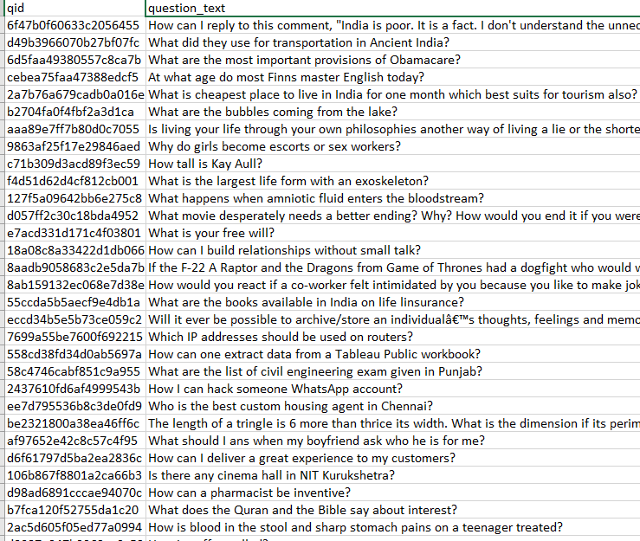
Data
Data stats:
Training data : 780k rows
Test data : 520k rows
No null entries
Large amount of training data
Other observations:
Sincere Question : ~94%
Insincere Question : ~6%

Slide 4
EDA (Intuitive observation)

Slide 5
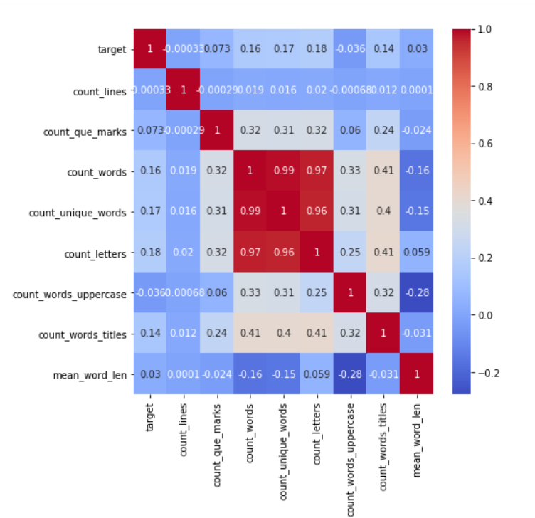
Correlation between extracted features

Slide 6

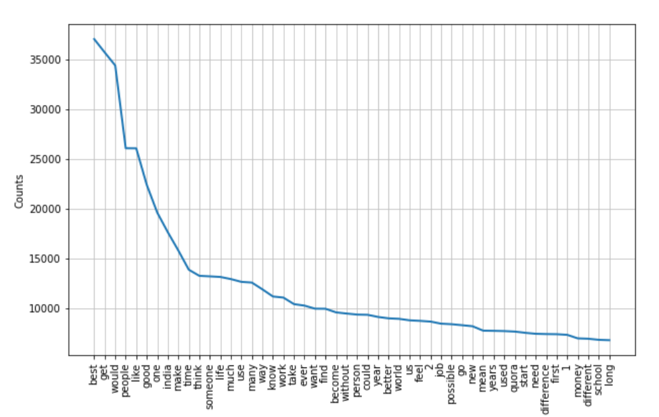
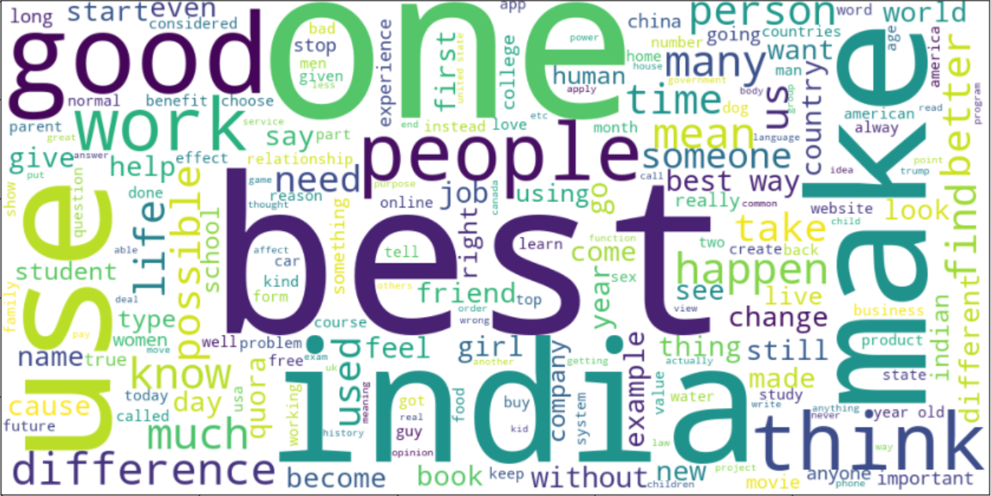
Sincere Question wordcloud

Slide 7
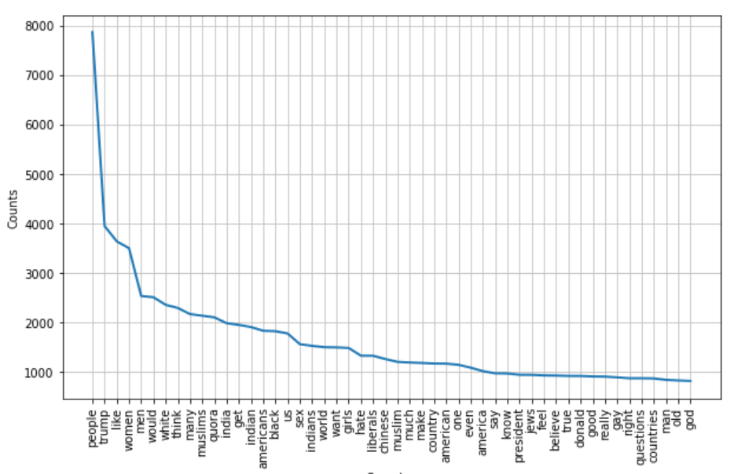
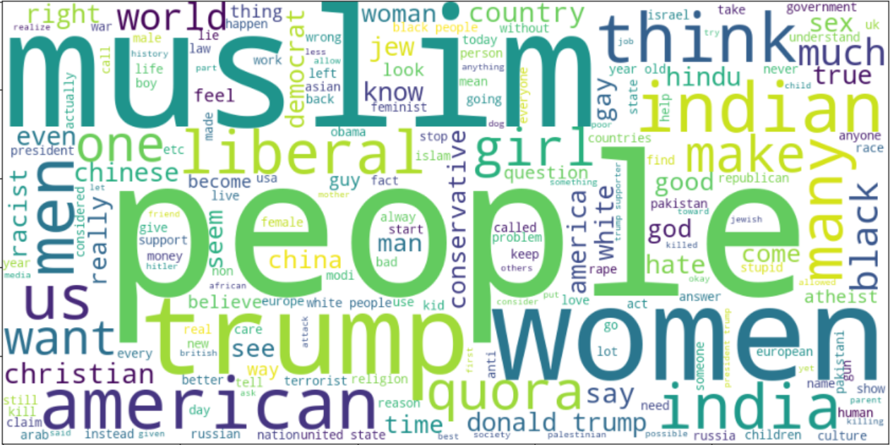
Insincere Question wordcloud

Slide 8
Data Cleaning

Slide 9

Data cleaning steps - Preprocessing
Converting to lower case
Removing irrelevant characters (Numbers and punctuations)
Removing whitespaces
Removing stop words
Removal of words of length <= 2
Removing hyperlinks
Removing math formula
Spelling correction
Contraction mapping
Lemmatization
Tokenization

Slide 10

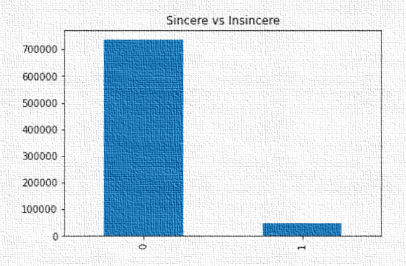
Handling Imbalance Distribution
Random under sampling
Intuition: Randomly eliminate instances from the majority class of a dataset
Disadvantage:
Discard useful information about the data
Sample chosen by random under sampling may be a biased sample
SMOTE - Synthetic Minority Oversampling Technique
Intuition: Generate new instances from existing minority cases
Augmentation
Generate additional, synthetic data using the data you have

Slide 11
Feature Engineering

Slide 12

Feature Hashing ( HashingVectorizer )
Intuition: Each word is mapped to a feature and using hash function we convert it to hash. We do not need to maintain the dictionary. Whenever the word comes again, we can increase the count of hash.
Advantages: Memory efficient. Better than bag of words.
Disadvantages: Once map is created, we cannot retrieve back the feature data.

Slide 13
Term Frequency - Inverse Document Frequency
Intuition: Quantify a word in questions. Weight of each word is computed which signifies the importance of the word in questions.
Advantages:
Importance of each word.
Disadvantages:
Relevance of words cannot be known.
Word_vectorizer
Char_vectorizer with n-gram range (2,4)

Slide 14
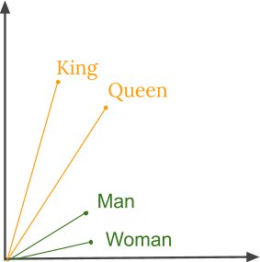
Exploring word embeddings
Advantages:
Train on billion-words corpus
Parallel processing
Handy for numerical calculation
Calculate similarities between samples

Slide 15
Exploring word embeddings
Google news
Score (0.41)
Glove
Coverage of words under Glove
Before Preprocessing (85% all data, 35% Vocabulary)
After Preprocessing (99% all data, 69% Vocabulary)
Score (0.43)

Slide 16
Exploring word embeddings
Disadvantage:
Does not solve below problems:
Learning representation for out-of-vocabulary words
Separating some opposite word pairs. For example, “good” and “bad” are usually located very close to each other in the vector space, which may limit the performance of word vectors

Slide 17
Word Embeddings break points
Assign rules to words that are only seen rarely in training
In tf-idf rules could only be formed on frequent words
The word embedding method contains a much more hidden and complex information.
Might be creating false patterns

Slide 18
Models Selection

Slide 19
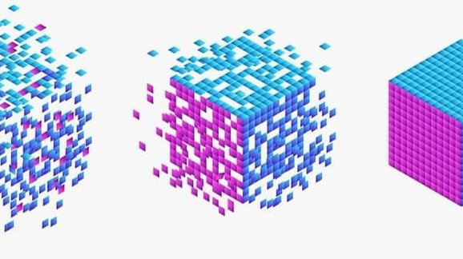
Model Selection
Logistic regression
Decision tree
Naïve Bayes
Light GBM
Voting Classifier

Slide 20
Timeline to best Score
Tf-idf (word-vectorizer), Logistic Regression, Under sampling (Score-0.48)
Tf-idf (word-vectorizer, char-vectorizer), Logistic Regression, Under sampling (Score-0.50)
Tried different word embeddings, models and sampling techniques – Didn’t get better Score
Tf-idf (word-vectorizer, char-vectorizer), Logistic Regression, Under sampling , Changed threshold (Score-0.60)
Added more preprocessing steps - Didn’t get better Score
Tf-idf (word-vectorizer, char-vectorizer), Logistic Regression , Changed threshold , Removed some preprocessing step (Like Stop words Removal, Lemmatizer)(Score-0.63)

Slide 21

References
https://neptune.ai/blog/data-augmentation-nlp
https://www.sciencedirect.com/science/article/abs/pii/S1568494618307130
http://mccormickml.com/2016/04/19/word2vec-tutorial-the-skip-gram-model/
https://towardsdatascience.com/decision-trees-in-machine-learning-641b9c4e8052
https://statquest.org/
https://towardsdatascience.com/how-to-tune-a-decision-tree-f03721801680
https://www.datacamp.com/community/tutorials/diving-deep-imbalanced-data
https://mlwave.com/kaggle-ensembling-guide/

Slide 22


